Slide 1



Share ThePik
Abhishek Harish, harish2
Xiupeng Ma, xma33
Kathryn Garbacz, kgarbac2
Chen Zhang, czhang49
A Venture by:
Notes:
1

Slide 2


Slide 3


Slide 4
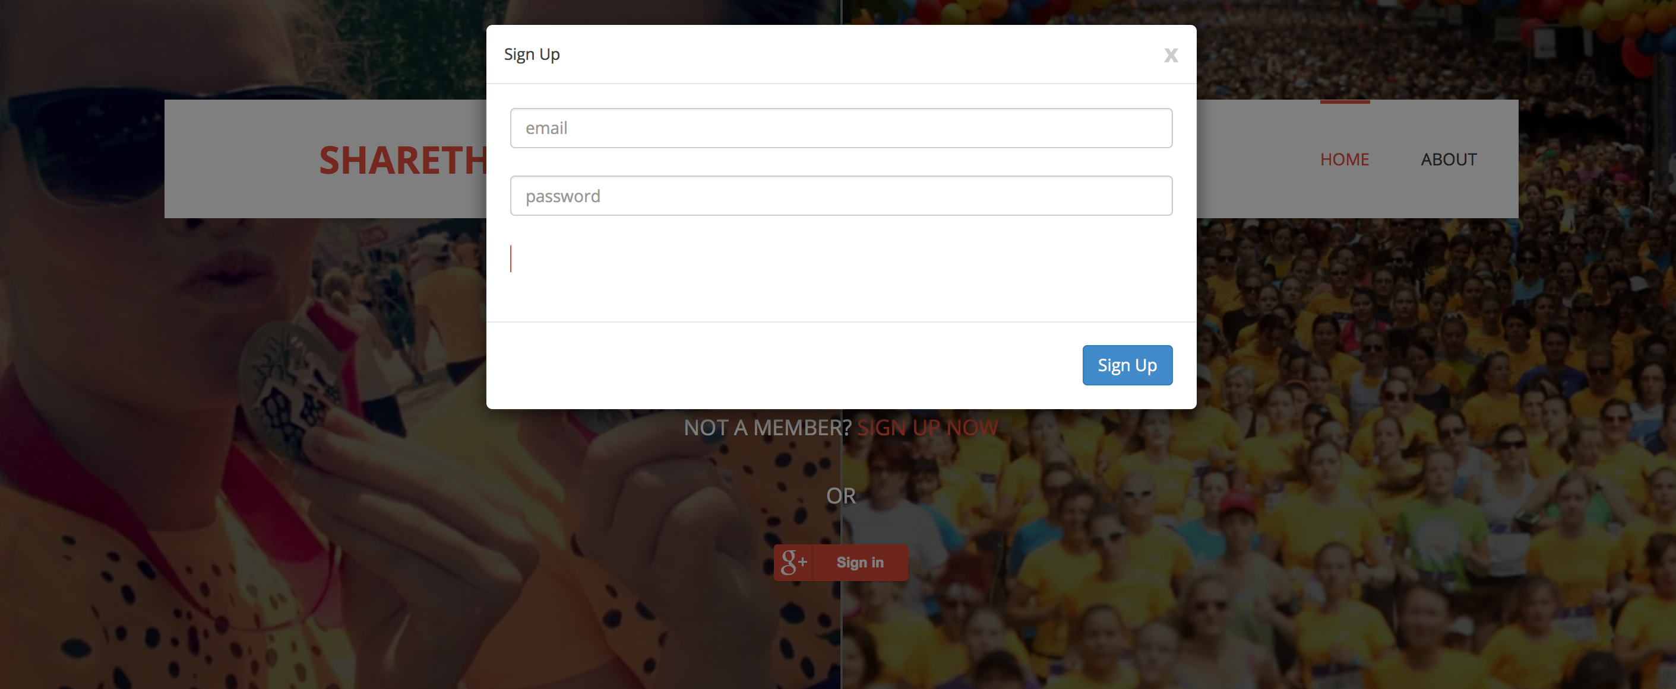

Slide 5
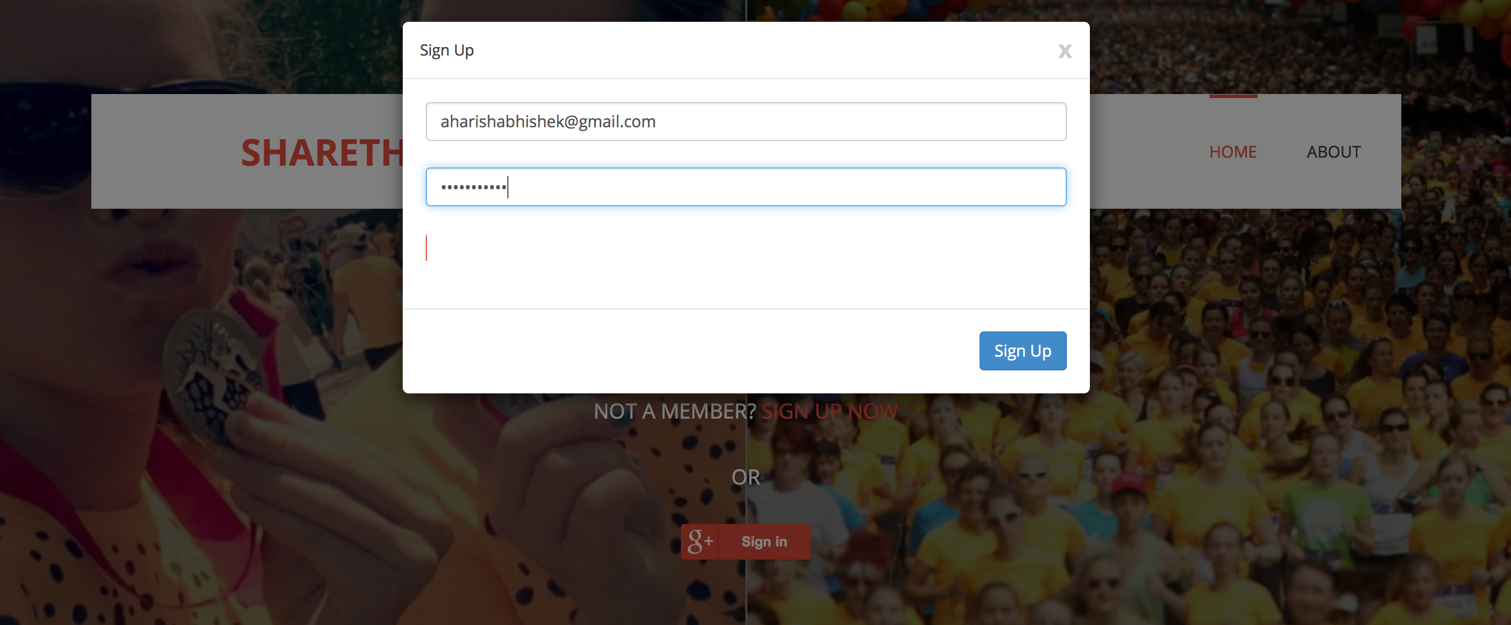

Slide 6
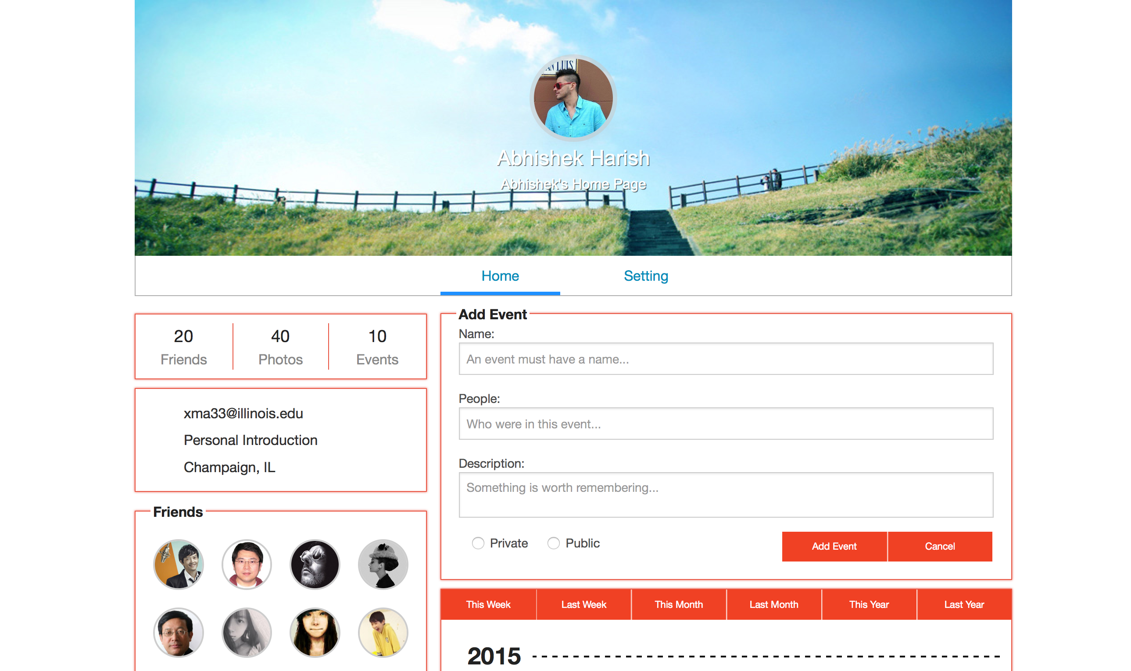

Slide 7
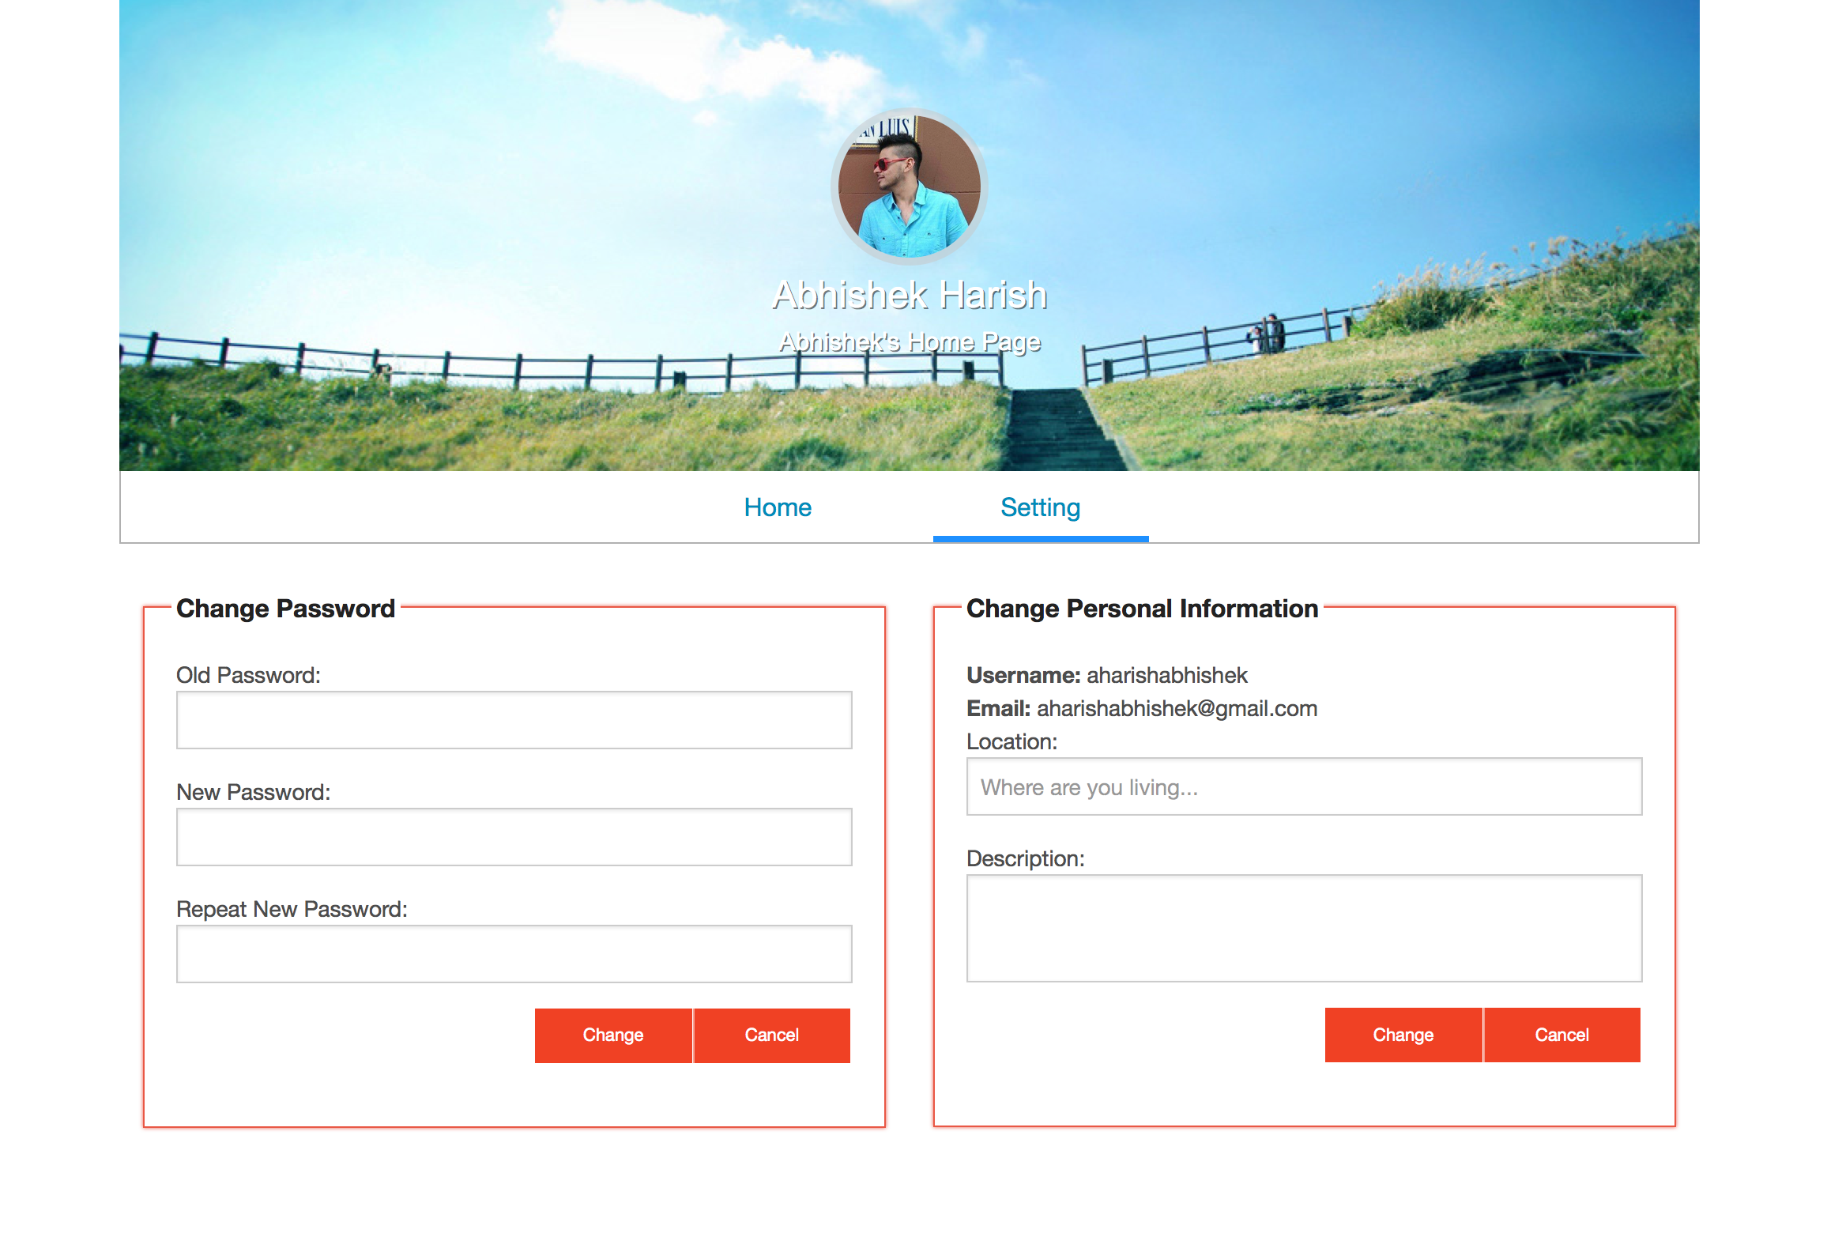

Slide 8
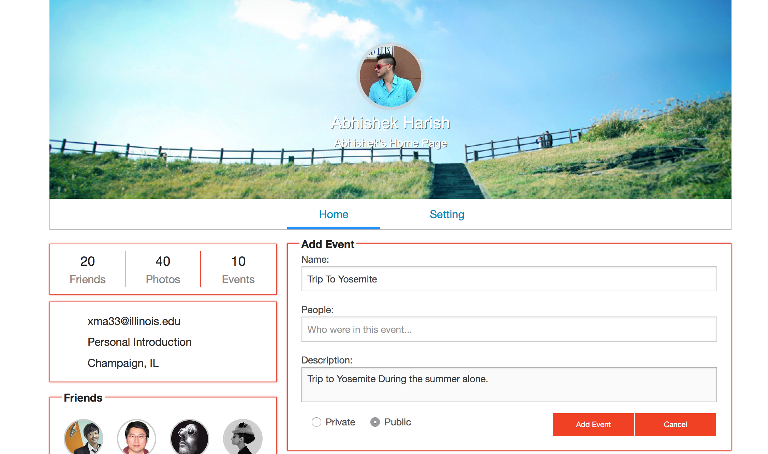

Slide 9


Slide 10
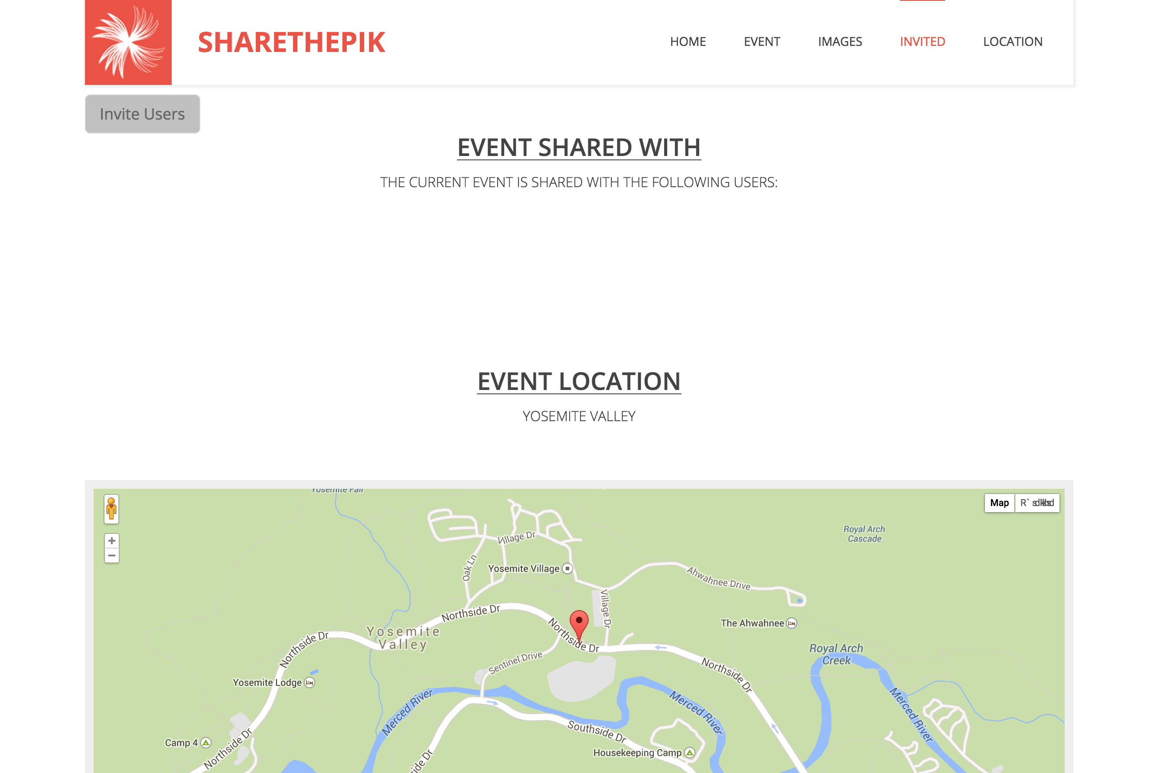

Slide 12
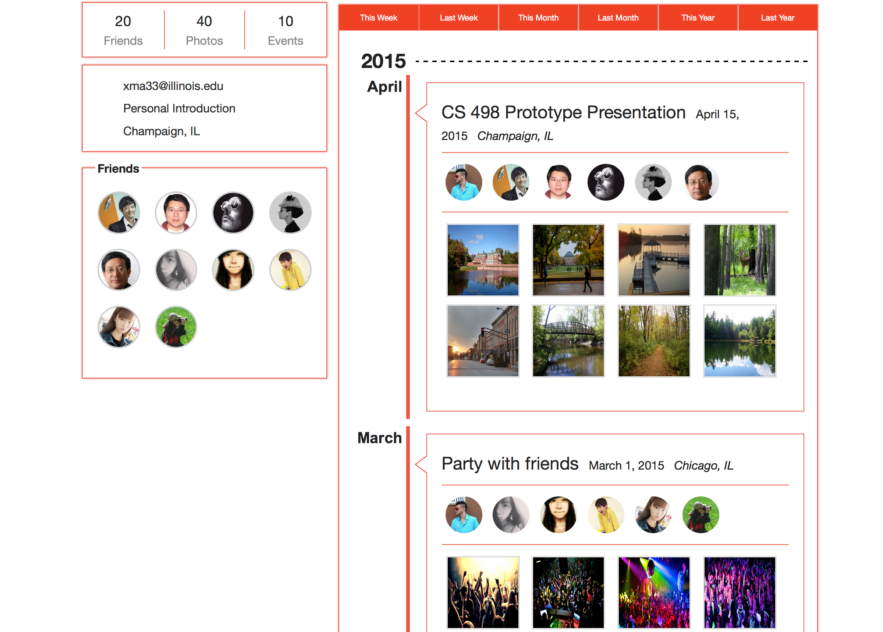

Slide 13


Slide 14


Slide 15


Slide 16
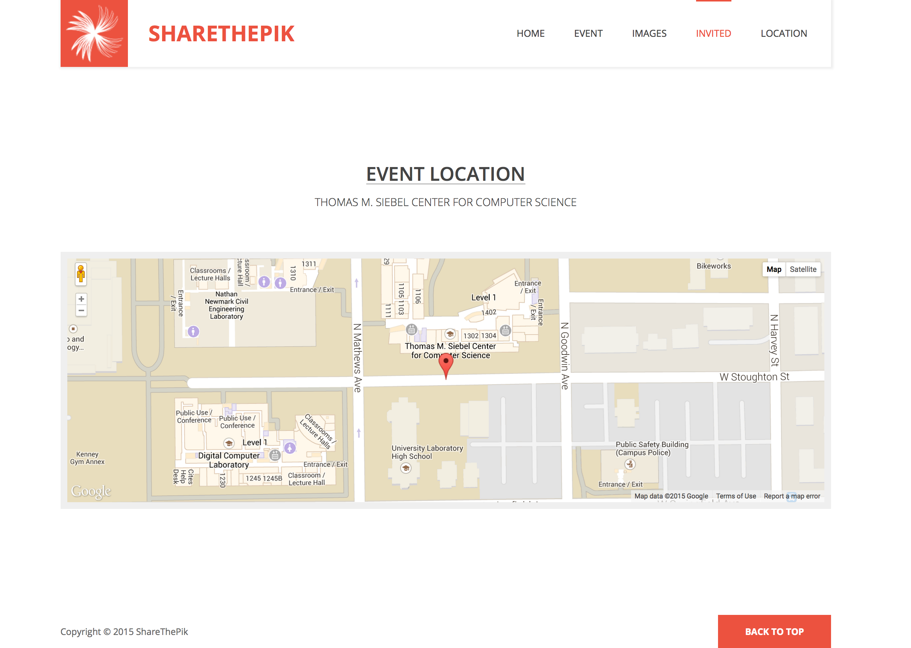

Slide 18

UPLOAD AN IMAGE WILL GO HERE.
We will select two images and click ‘Upload’
And they will show up on the next page
(Put a link to the next page from ‘Upload’

Slide 19
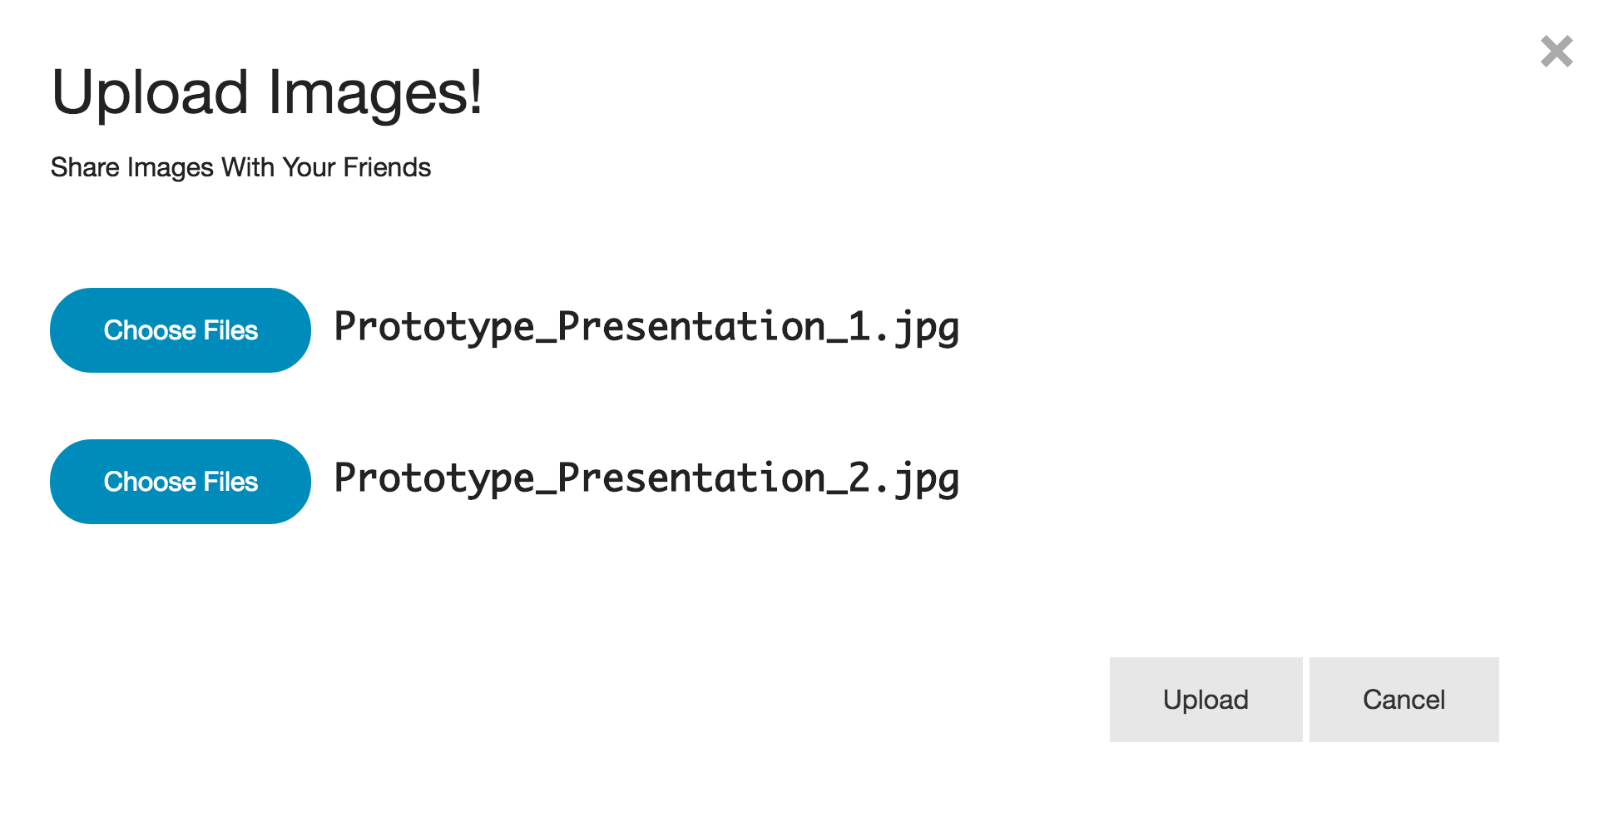

Slide 20


Slide 21


Slide 23


Slide 24
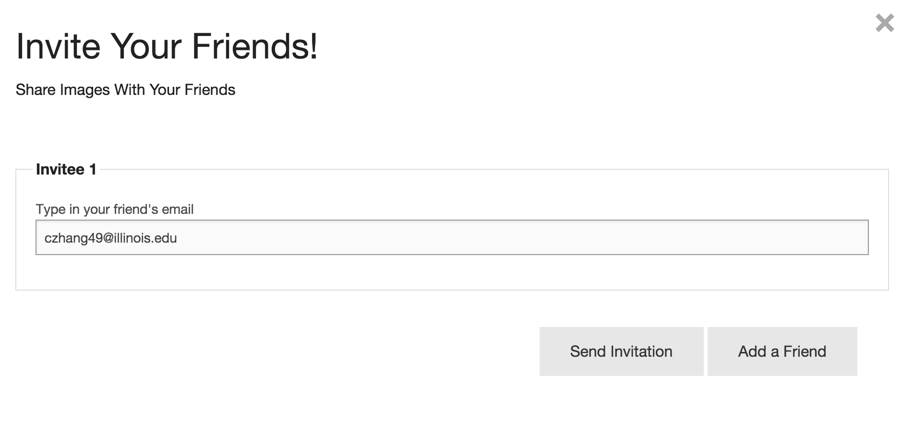
Invite a user will go here.
Clicking on Invite User leads to a page where
We can search for the user and select Chen. Once we select him, it will link to the next page
Where he will be added to the list of users sharing
This event.

Slide 25


Slide 26
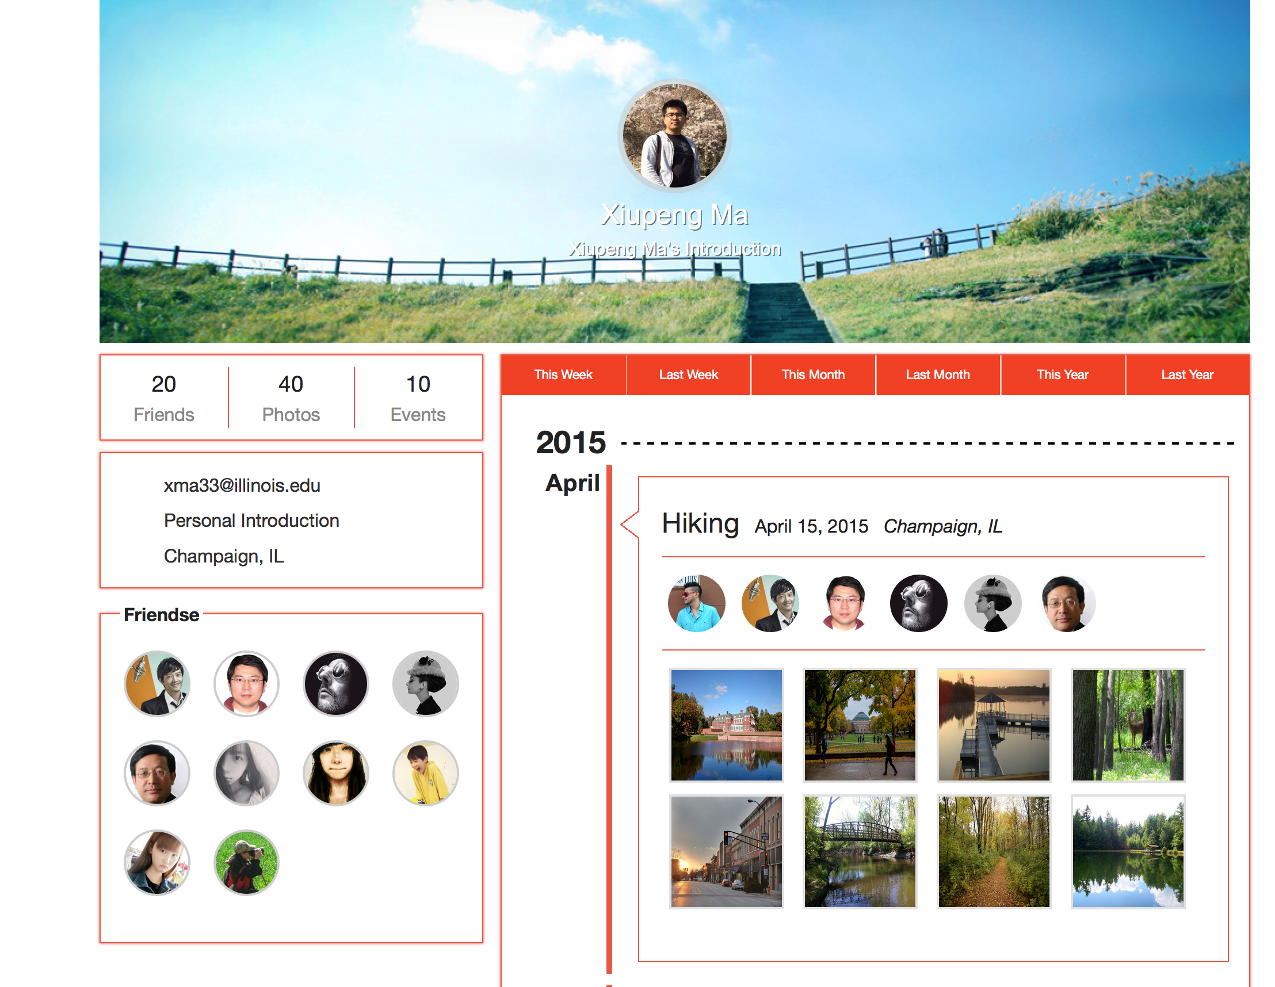

Slide 27
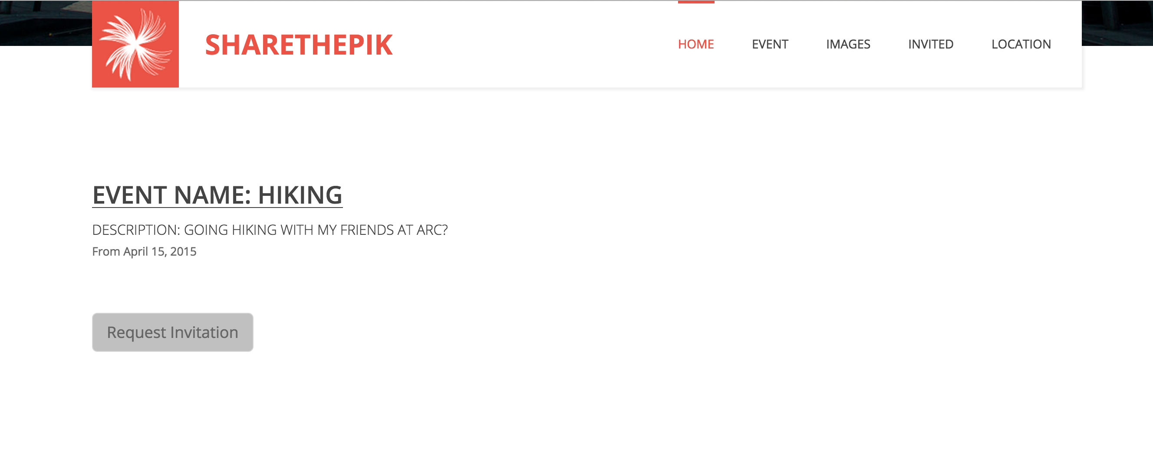

Slide 28
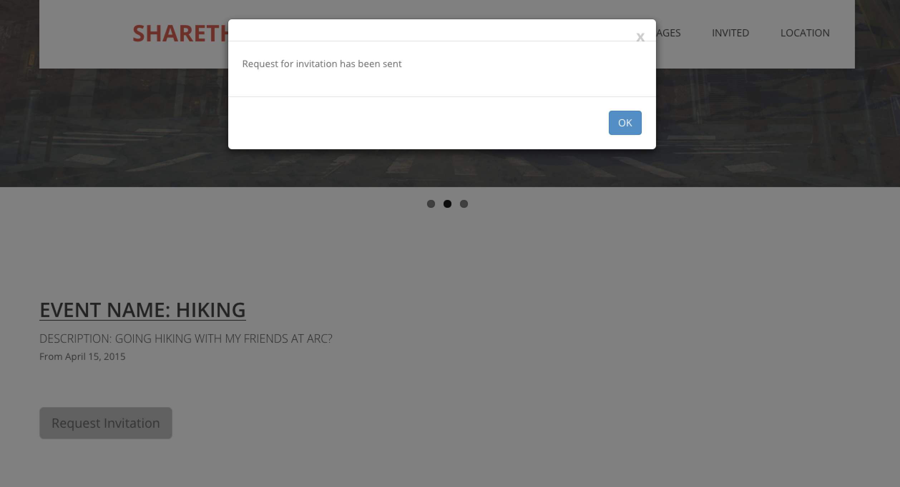

Slide 30
Thank You !
Abhishek Harish, harish2
Xiupeng Ma, xma33
Kathryn Garbacz, kgarbac2
Chen Zhang, czhang49
Notes:
30

